Slide 1

CSE 306 Project Idea Presentation

Slide 2
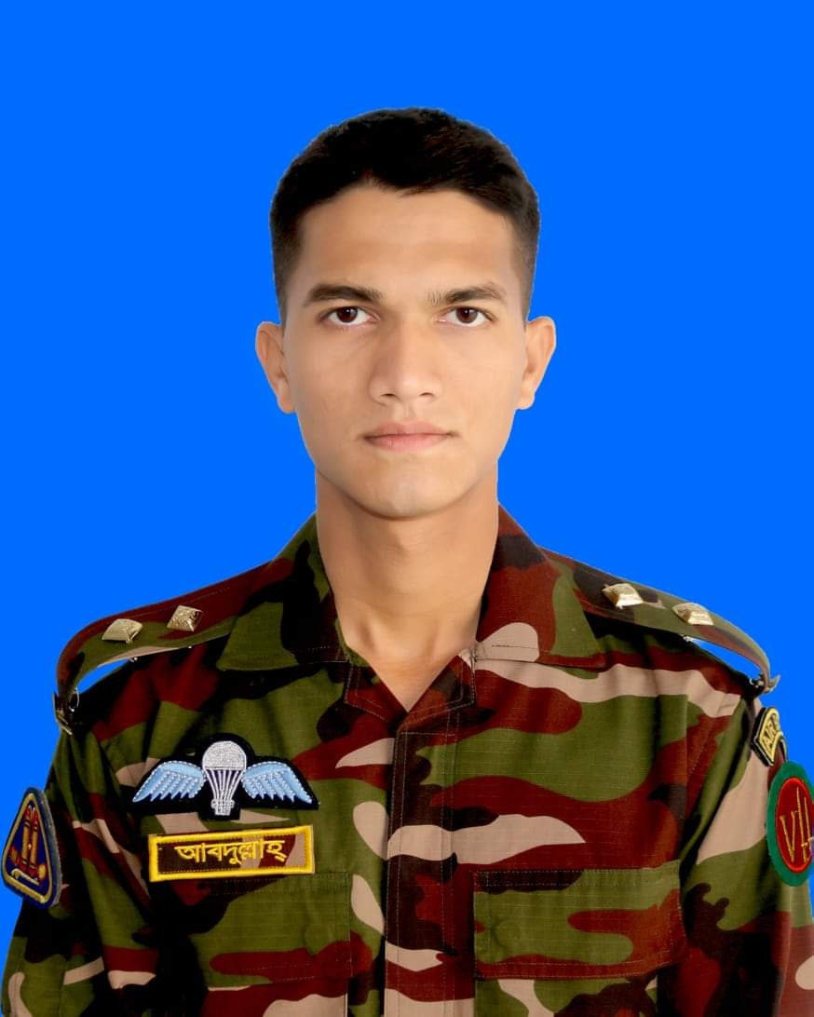

Group Members
Abdullah Al Mahmud
ID: 201814101
Student of MIST
Abdullah Al Masum ID: 201914044
Student of MIST
Riasat Haque
ID: 201914042
Student of MIST

Slide 3
Digital Home Automation
1

Slide 4
Project Objective
To automate the whole operations of smart home using wireless protocol for electronic gadgets in home

Slide 5
Project Description
We will create a radio frequency based wireless protocol to automate home appliances. For simplicity, we will use bluetooth controller app to communicate with microcontroller. In addition,we will try to automate the fire alarm by using temperature based sensors.

Slide 6
Project Atondro
2

Slide 7
Project Objective
To create a simple and affordable solution of finding wandering children
To build low cost monitoring system for autistic children
To alert the user if an item goes to certain range

Slide 8
Project Description
We will create an arduino based project which will help to notify parent / Guardians if their little children or autistic children get lost from them in a crowded shopping mall or from a park. Then this system will send an alert notification to their guardians phone number. For simplicity, we will use distance sensor to track children.

Slide 9
Project Durotto
3

Slide 10
Project Objective
To create a simple and affordable solution of maintaining social distance in this pandemic situation

Slide 11
Project Description
We will create an arduino based project which will help it's user to maintain social distance from all direction around him. To do that, we have decided to place the sensors inside a cap. When any stranger will come close to the user, a buzzer will alert the user. For simplicity, we will use ultrasonic distance sensor to keep maintain the safe distance.

